Slide 1
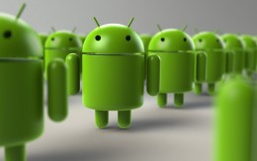
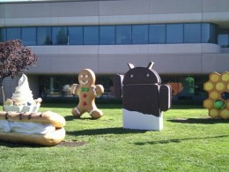
International Institute of
Professional Studies
Presentation on:
COMPUTER
APPLICATIONS :
SUB-TOPIC:
Features of UNIX, LINUX,Android OS

Slide 2

I.I.P.S, DAVV,INDORE
Features of UNIX, LINUX,Android OS
Prepared and Presented by:
Mr.Naresh Dembla
Asst. Proff.,IIPS, DAVV, Indore

Slide 3
What is UNIX-OS ?
Unix is multitasking , multiuser computer operating system
Originally developed in 1969 by a group of AT and T employees at Bell Labs, including Ken Thompson
Unix operating system was first developed in assembly language, but by 1973 had been almost entirely recorded in greatly faciliting its further development and porting to other hardware

Slide 4
Features of Unix-OS
UNIX is written in C, a high level language and is thus portable to variety of computers.
The interface provided to users is simple and powerful. It provides most of the services which a user normally wants
The file system used by UNIX is hierarchical which allows efficient implementation and easy maintenance

Slide 5
Features(continue...)
UNIX considered all files to be a continuous sequence of characters, known as a byte stream. Application programmes thus have the flexibility to format the files as per their requirement
UNIX treats peripheral devices as if they are files.Peripheral devices are given file names and thus programs can access devices with the same syntax they use when accessing regular files.Thus , UNIX provides a simple, consistent interface to peripheral devices

Slide 6
Features (continue...)
UNIX is multiuser, time- share , multiprogrammed OS.Individual user can execute several processes simultaneously . It can also be time shared by several users.
UNIX supports a scripting language called shell which allows complex jobs to be performed using several built in programs provided by UNIX the output of a shell command can be fed as input to another shell command .

Slide 7
Features (continue...)
UNIX assumes no knowledge of machines architecture from a use . Thus programs written using UNIX can be run on a variety of architectures.
UNIX can support any programming language that maps user request for OS services to the standard set of request used by UNIX.

Slide 8
Background on Linux-OS
Version of UNIX
Linus Torvalds – Creator of Linux
Open Source Operating System
Free Software
Source Code Available

Slide 9
Where is Linux-OS Used?
75% of respondents were already using Linux and another 14% were evaluating it
43% of all web sites use Linux servers running the Apache Web server

Slide 10
How is Linux-OS Used?
Personal Workstation
File and Print Server
Internet Service Provider
Three-tier Client/Server
Turnkey System

Slide 11
Using Linux on Personal Computers
Linux kernel for free
Kernel is central component
Kernel can be customized to user’s needs

Slide 12
Linux-OS Distributions
Corel Linux
Debian GNU/Linux
OpenLinux (Caldera)
Red Hat
Slackware
SuSE
TurboLinux

Slide 13
Working with Linux-OS
Graphical User Interface
  X Window System
  SuSE KDE SuSE

Slide 14
Software Applications
OpenOffice: word processing, spreadsheets, drawing
Adobe Acrobat Reader
Konqueror: The KDE File Manager and Web Browser
Kmail: The KDE Mail Application
Evolution: An Email and Calendar Program
Sound Applications

Slide 15
Software Applications (continued)
TV, Video, Radio, and Webcam
K3b: The KDE Burning Application
Digital Cameras
Kooka: Scanning Application
Graphics with the GIMP
Shell system

Slide 16
Linux Directory Structure
Store drives
Accessing data using folders
Root directory:
  beginning of file system

Slide 17
Subdirectories
Examples of Subdirectories
/root directory, starting point of the directory tree
/home (private) directories of users
/devDevice files that represent hardware components
/etc Important files for system configuration
/etc/init.d Boot scripts/usr/binGenerally accessible programs

Slide 18
Why Use Linux-OS ?
Costs less
Stable
Reliable
Extremely powerful

Slide 19
Features of linux-OS
Multitasking
Multiuser
Multiplatform
Multiprocessor
Multithreading
Runs in protected mode on the 386
Reliable
Runs on variety of platforms
Interprocess communication

Slide 20
Features (continue...)
Multiple virtual consoles
Appletalk server
Support for many national and customized keyboards
Special file system called UMSDOS which allows Linux to be installed on a DOS file system
Linux supports several common file system , including matrix , xenix .

Slide 21
What is Android-OS ?
A Software platform and operating system for mobile.
Based on the Linux kernel.
Android was found way back in 2003.
It was developed in Palo Alto, California.
Android was developed by the Andy Rubin, Rich Miner, Nick Sears and Chris White.
Android was purchased by the GOOGLE in AUGUST,2005 for 50 million $.

Slide 22
Features of Android-OS
Android is not a single piece of hardware.
Android supports wireless communication using:-
Bluetooth connectivity
3G Networks
4G networks
802.11 Wi-Fi networks

Slide 23

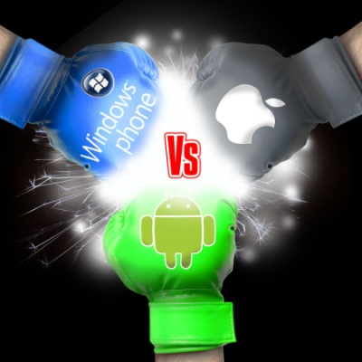
Other then Android there are several other mobile operating system which is used.
Symbian, iOS, windows this are one of the most used mobile operating systems.

Slide 24

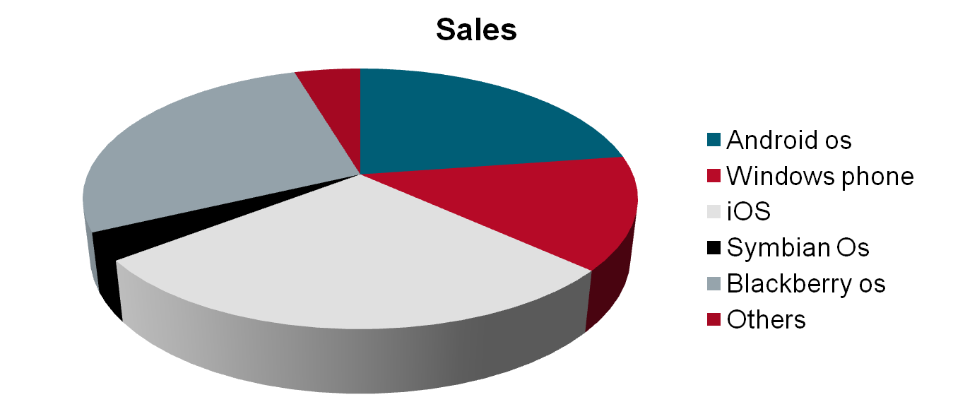

Slide 25

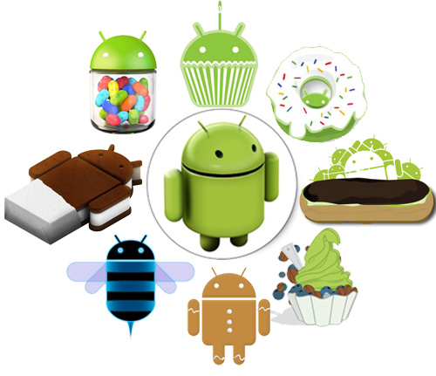
    Android Beta
First Version of Android.
The focus of Android beta is testing incorporating usability.
Android beta will generally have many more problems on speed and performance.

Slide 26

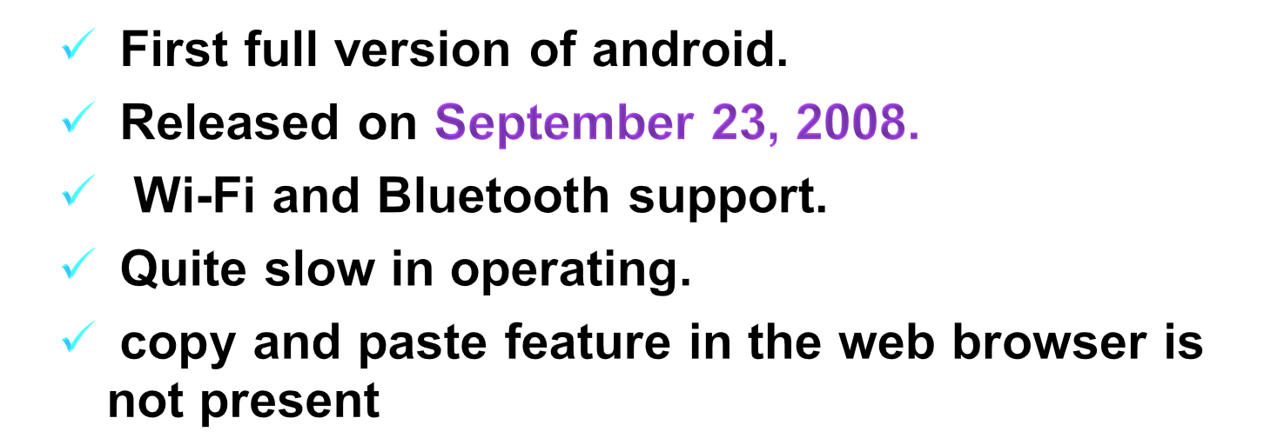
Version of Android-OS
First full version of android.
Released on September 23, 2008.
Wi-Fi and Bluetooth support.
Quite slow in operating.
copy and paste feature in the web browser is not present.

Slide 27


Versions (continue...)
Android Cupcake 1.5
Released on April 30, 2009.
Added auto-rotation option.
Copy and Paste feature added in the web browser.
Increased speed and performance but not upto required level.
Android Donut 1.6
Released on October 26, 2009.
Bluetooth 2.1 support.
Improved typing speed on virtual keyboard, with smarter dictionary.
no Adobe flash media support.

Slide 28

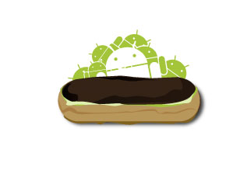
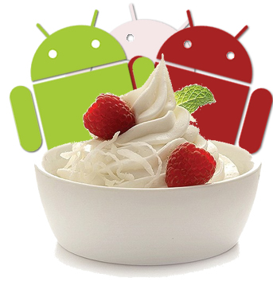
Versions (Continue...)
Android Éclair 2.0/2.1
Released on October 26, 2009.
Bluetooth 2.1 support.
Improved typing speed on virtual keyboard, with smarter dictionary.
no Adobe flash media support
Android Froyo 2.2
Released on May 20, 2010.
Support for Adobe Flash 10.1
Improved Application launcher with better browser
No internet calling.

Slide 29

Versions (continue...)
Android Gingerbread 2.3
Voice search and Search box were added.
Released on September 15, 2009.
Faster OS boot times and fast web browsing experience

Slide 30

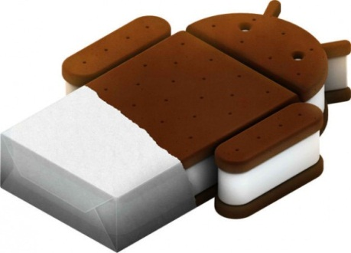
Versions (continue...)
Android Honeycomb 3.0
Released on February 22, 2011.
Ability to encrypt all user data.
This version of android is only available for tablets.
support for multi-core processors
Android IceCreamSandwich(ICS) 4.0
Released on November 14, 2011.
Virtual button in the UI.
A new typeface family for the UI, Roboto.
Ability to shut down apps that are using data in the background.

Slide 31

Versions(continue...)
Android JellyBean 4.1
Released on June 27, 2012.
Latest version of Android.
Smoother user interface.

